Slide 1
Direct Alcohol Fuel Cells
Keywords
DAFC - Direct Alcohol Fuel Cells
DMFC - Direct Methanol Fuel Cells
DEFC - Direct Ethanol Fuel Cells
PEMFC - Proton-Exchange Membrane Fuel Cells
CH - Carbon Hydrogen
CC - Carbon Carbon
CO - Carbon Oxygen
Pt - Platinum
Ru - Ruthenium

Slide 2
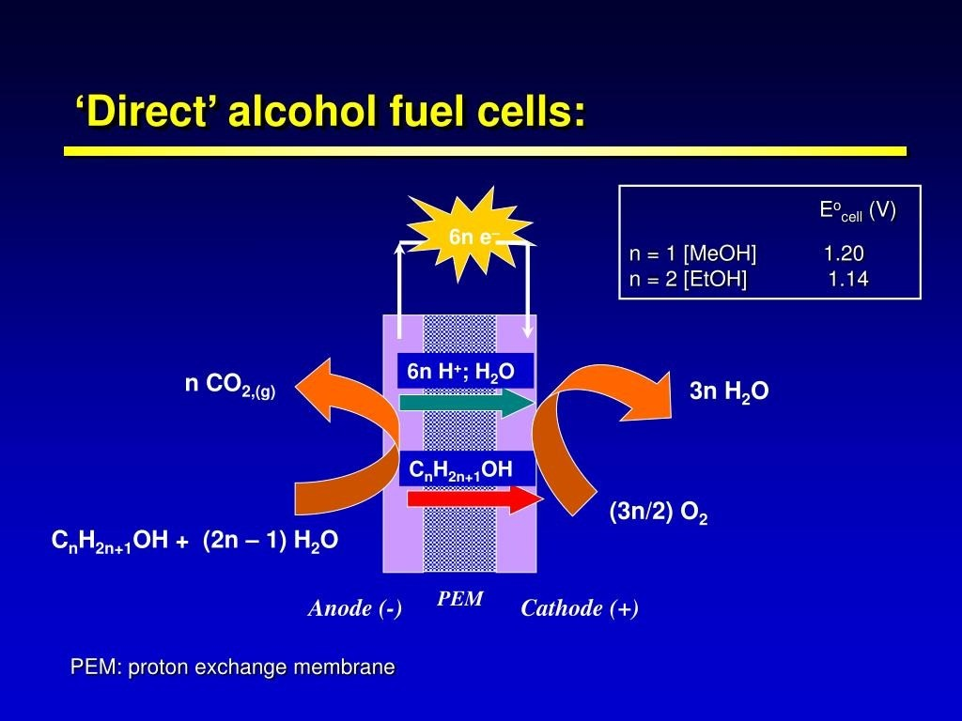

Slide 3
Direct Alcohol Fuel Cell
Direct Alcohol Alkaline Fuel Cell
Direct Alcohol PEM Fuel Cell
Direct Alcohol AEM Fuel Cell

Slide 4
Methanol
Liquid fuel
Easy to transport and distribute
5 KWh/l (6 KWh/Kg) energy density
6 electrons per molecule of methanol oxidized
Electrooxidation is easy in alkaline condition
Not a primary fuel
Toxic
Ethanol
Non-conventional liquid fuel - method of production is well established
Easy to transport and distribute
5.9 KWh/l (7.44 KWh/Kg) energy density
C-C bond cleavage at low temperature
12 electrons per molecule of ethanol oxidized
Electrooxidation is easy in alkaline condition
Non toxic

Slide 5
Performance of fuel cell for different fuels
0.8
0.6
Cell voltage (V)
0.4
Ethanol Methanol
Sodium borohydride
0.2
0.0
0 200 400
600
800
Operation time (hours)

Slide 6
PEMFC/DAFC Challenges
Membrane: high temp operation, high proton conductivity, no electron conductivity, low fuel cross-over, thermal, mechanical and chemical stability, low cost Polyfuel
GDL: uniform distribution of fuel/oxidant on to electrode, excellent electron conductivity, heat conductivity, catalyst
support, reasonably stiff and flexural strength, low cost
Indigenous development
Bipolar Plate: thinner plate and low density material, excellent electron conductor, fuel, oxidant and by product transport (corrosion resistant), high heat conductivity, high flexural strength, low cost (graphite/SS)
Catalyst: low loading, new catalyst – no deactivation, CO tol. C-C bond cleavage at low temp.
Stack Eng.: Improved BOP, thermal and water management

Slide 7
Obstacles associated with the use of hydrogen
Generation of hydrogen gas —> High cost
Explosion hazard
Difficult to store and distribute
Low power output per unit weight of the fuel cell and fuel processor
Low energy density: 0.002772 KWh/l at atm. conditions (33 kWh/kg)

Slide 8
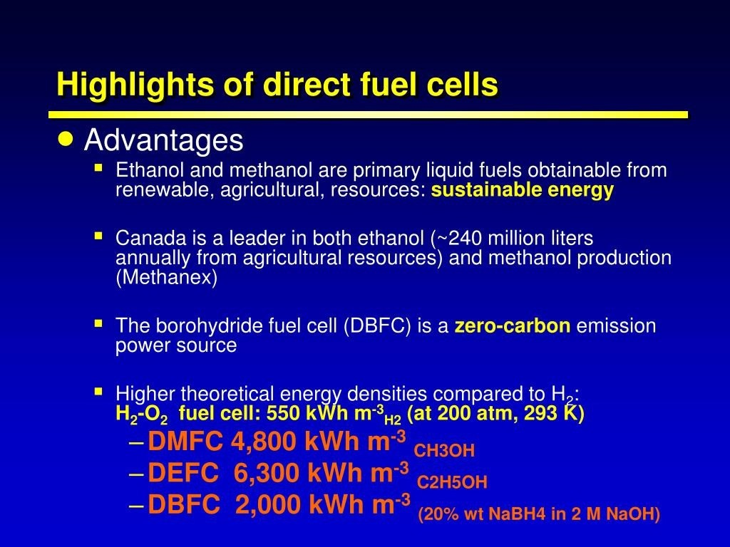

Slide 9
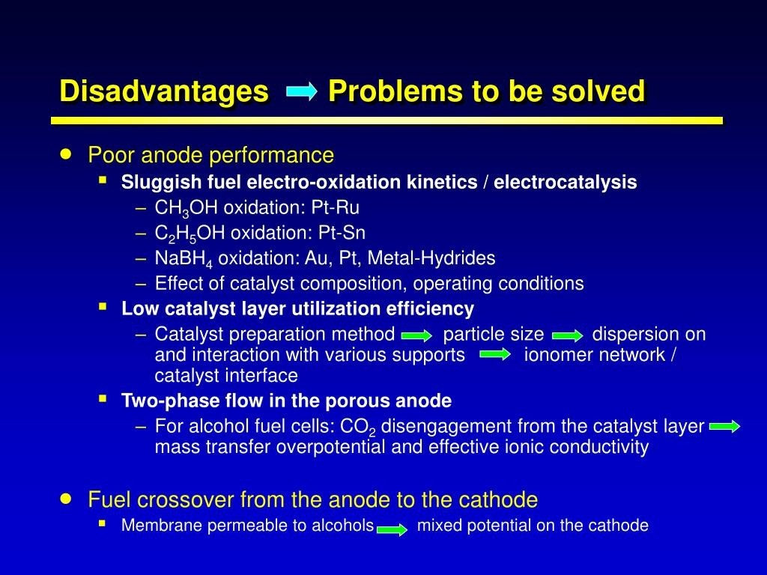

Slide 10
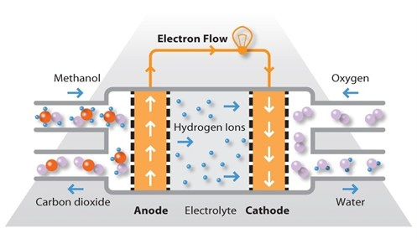
The Anode Problem

Slide 11
Literature Review on Direct Alcohol
Alkaline FC
Fuel/ oxidant | System information |  |  | Operat- ing temp. (ºC) | Current density (mA cm⁻²) | OCV (V) |  | References
 | Anode | Cathode | Electrolye
MeOH/ air | Pt | Carbon | 10M KOH | 25 | 2 | 0.9 |  | Vielstich (1965)
MeOH/ air | Pt/Pd | Ag | 11 M KOH | 25 | --- | 1.0 |  | Perry (1976)
MeOH/ not specified | Fe(III)- treated graphite | Ag(I)- treated graphite | 6 M KOH | 25 | 18 | 0.85 |  | Verma et al. (2000)
MeOH/ air | Pt/C | Pt/C | AEM | 60 | 69.3 | 0.75 |  | Yu et al. (2004)
NaBH₄/ air | Au/Pt | Not specified | AEM | 25 | 152 | 1.1 |  | Amendola et al. (1999)
NaBH₄/ H₂O₂ | LaCeNd PrNiAl MnCo | Pt/C | Pretreated Nafion- 117 | 70 | 500 | 1.25 |  | Choudhury et al. (2003)
A typical cell voltage of 700 mA cm⁻² at 0.6 V is treated as a good PEMFC operation

Slide 12
Thank you

